Slide 1

MAJOR PROJECT
Problem Statement
Your task aims to compromise the vulnhub machine and reach root and access Westwild and collect westwild flags on the way.
Report Prepared by :
Sri krishna
Cyber security dept

Slide 2
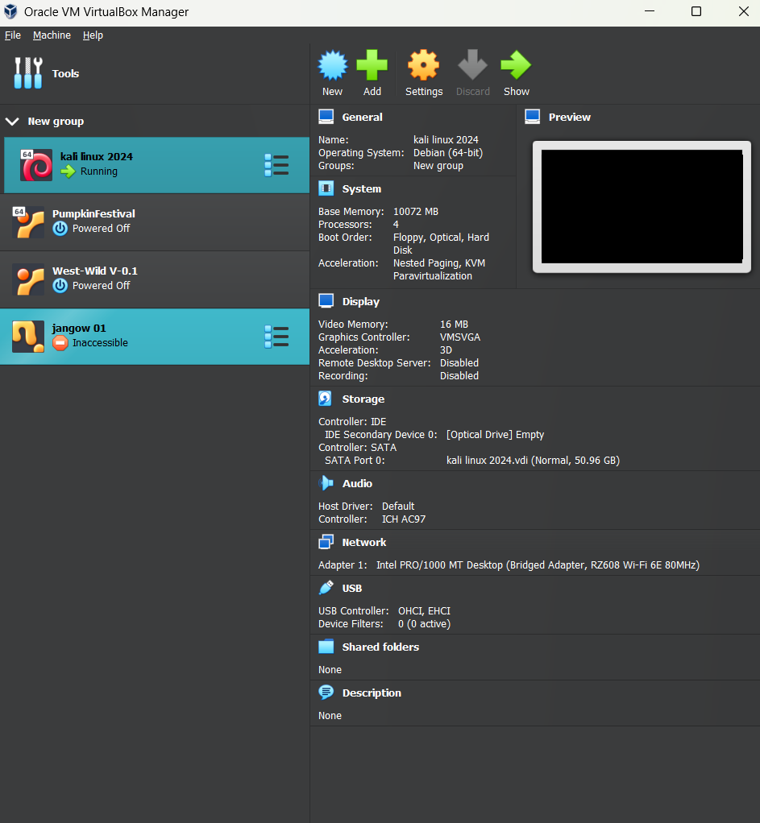
First download the westwild machine and add it to virtual box.
After adding to virtualbox set us the settings to bridged Adaptor Network.
Check both the machine kali and westwild be in the same network, if in different network the machine doesn’t run.

Slide 3
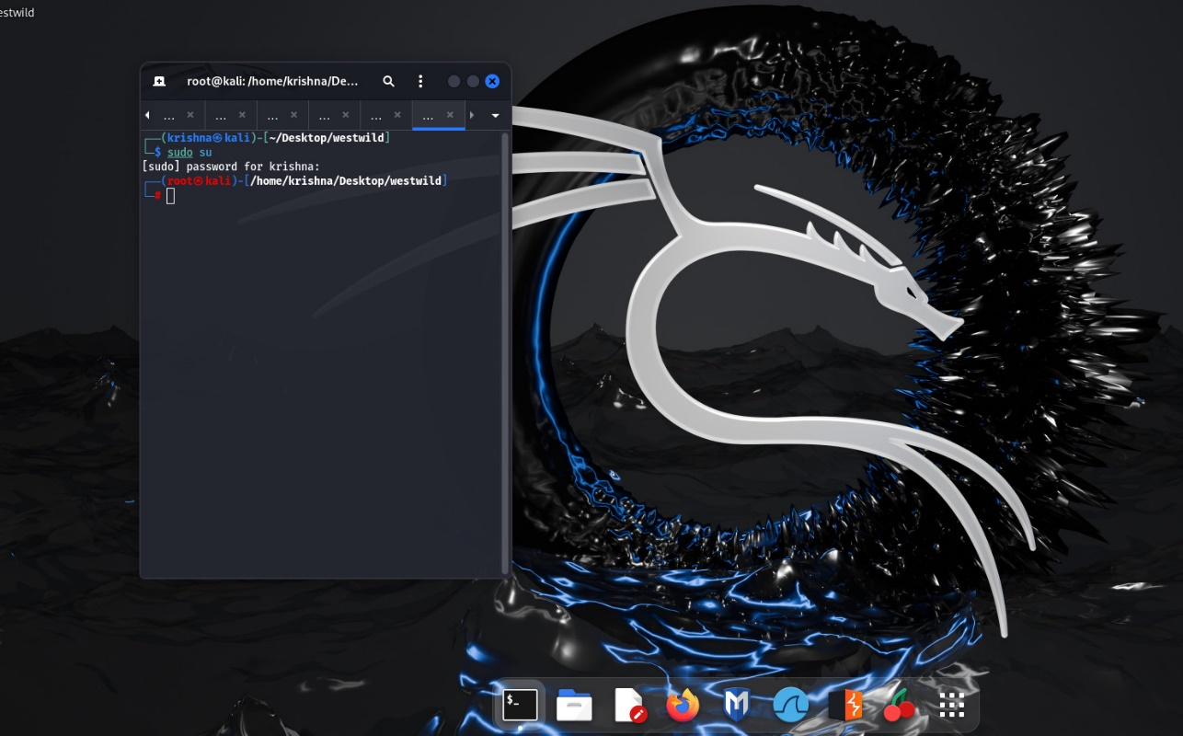
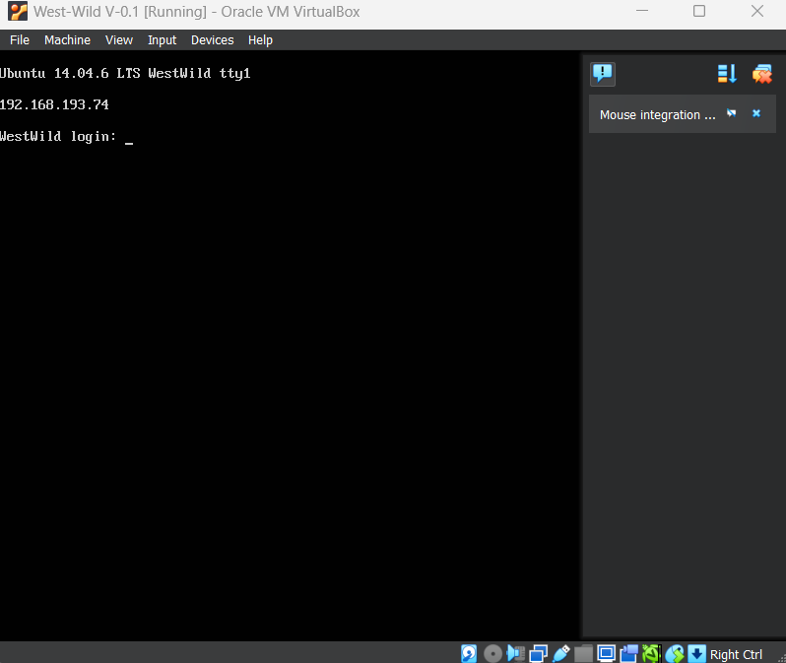
These are the interface of the machine of kali linux and westwild.
Now,we need to find our ip address of kali linux. use command of ipconfig to find our ip address .My system ip Address is 192.168.193.193.
Our westwild ttyl ipaddress is 192.168.193.74.

Slide 4
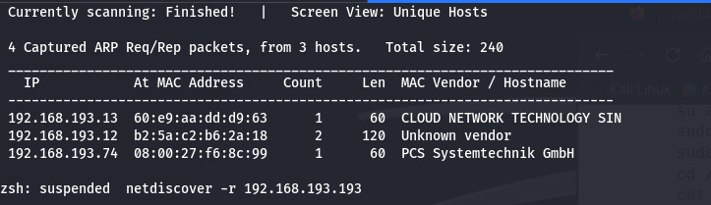
Netdiscover tool
Netdiscover is a simple ARP scanner that can be used to scan for live hosts in a network. It can scan for multiple subnets also.This can be used in the first phases of a pentest where you have access to a network. Netdiscover is a simple initial-recon tool that can be very handy.
Use command to scan the our ipaddress
Netdiscover -r 192.168.193.193
. -r range: scan a given range instead of auto scan
In this scan we got the information of that our ipaddress is connect with another machine also.
The ipaddress of 192.168.193.74 is a westwild ipaddress.so,we got connection with kali and westwild.
Now,we should scan the ipaddress with the help of nmap tool.

Slide 5
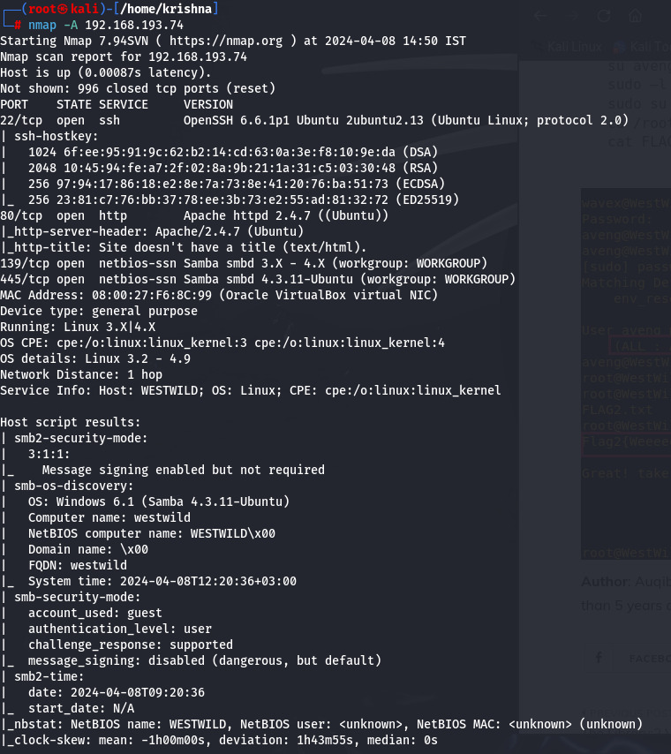
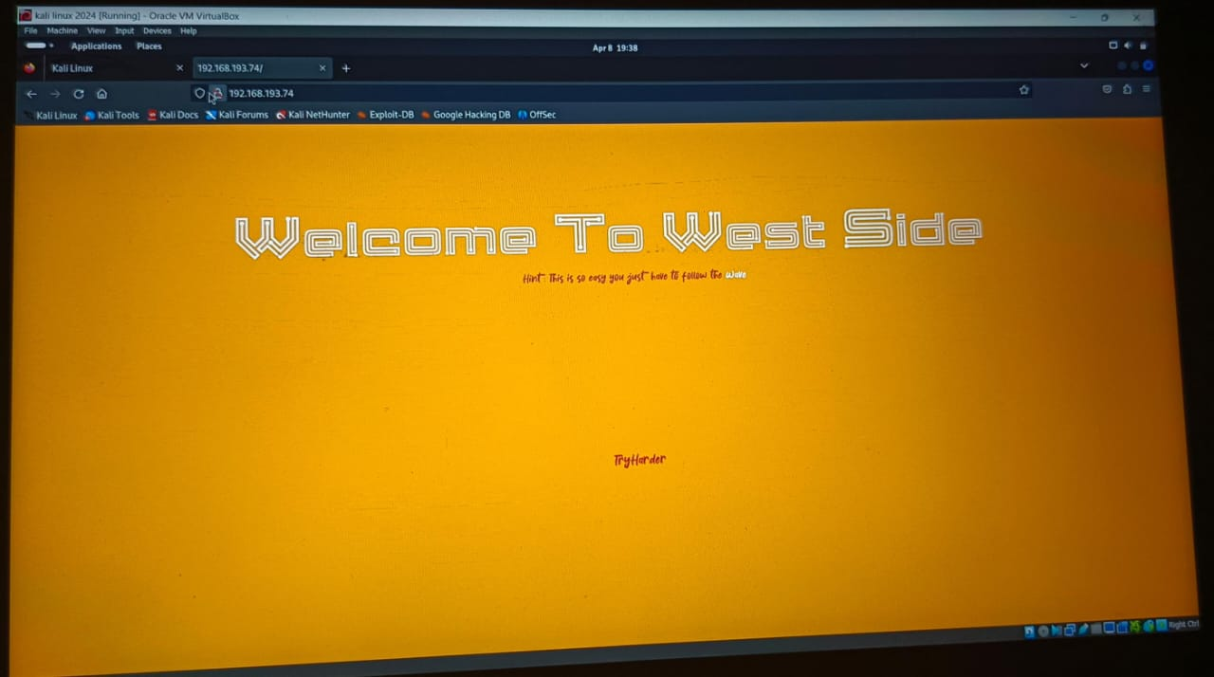
nmapTool
Nmap is short for Network Mapper. It is an open-source Linux command-line tool that is used to scan IP addresses and ports in a network.Nmap allows network admins to find which devices are running on their network, discover open ports and services, and detect vulnerabilities.
use command to find ports nmap –A 192.168.193.74
here,we see 4 ports are opened 22,80,139,445.
22/tcp open ssh
80/tcp open http
139 and 445/tcp open smbd
There is nothing to find with this information.but we can find a png page by using ipaddress in fire fox.

Slide 6
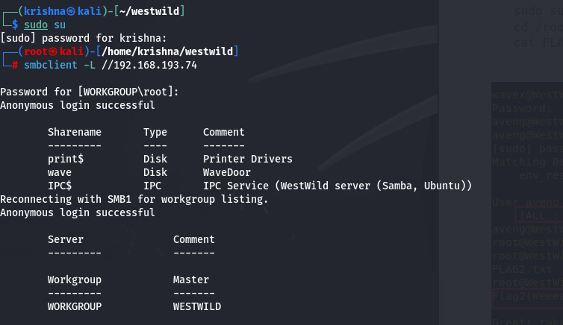
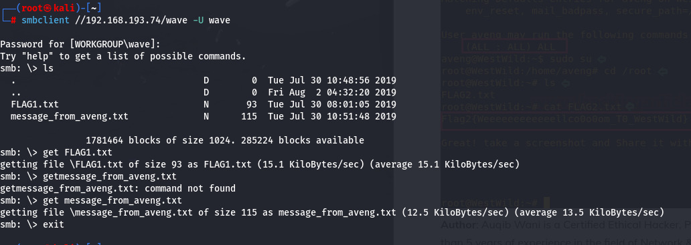
We saw port 445 (smb) is open which means there may be a shared directory, so to further enumerate this as well as other ports, we tool help of Enum4Linux tool.
To confirm our finding of the shared directory we used smbclient with a blank password and we got lucky and were able to list the shared directories.
smbclient –L \\192.168.1.104 smbclient \\192.168.1.104/wave ls get FLAG1.txt get message_from_aveng.txt
Inside the wave directory, we got two text files FLAG1.txt & message_from_aveng.txt which we download to our kali system using get command.

Slide 7
In smb command line we should use get command. Without using get command the directorys are not going to be saved in the system.
Get FLAG1.txt
Get message_from_aveng.txt
We looked into the contents of these text files and found a base64 code inside the FLAG1.txt file. We should decode the code using the command of echo. At the fist use cat command to open the txt.

Slide 8
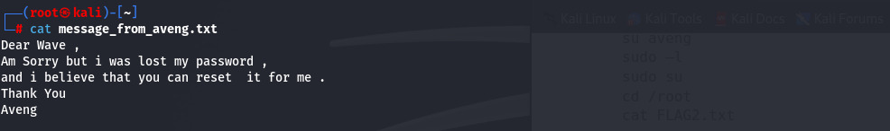
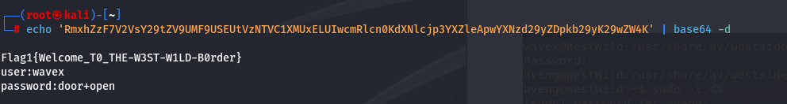
We looked into the contents of these text files and found a information inside the message_from_aveng.txt file. In this the information is useful that there is no password to access.
Now,we should the given base64 code by using command of echo ‘<code>’ | base64 –d.
We get the user name and password
User:wave
Password:door+open
We have got a username and a password, so we tried to SSH the target system and were successfully able to log in.
Now our job was to get to the root shell and in the process of doing so, we found a writable directory westsidesecret. And when we had a look inside the directory we got a script file named ififorget.sh.

Slide 9
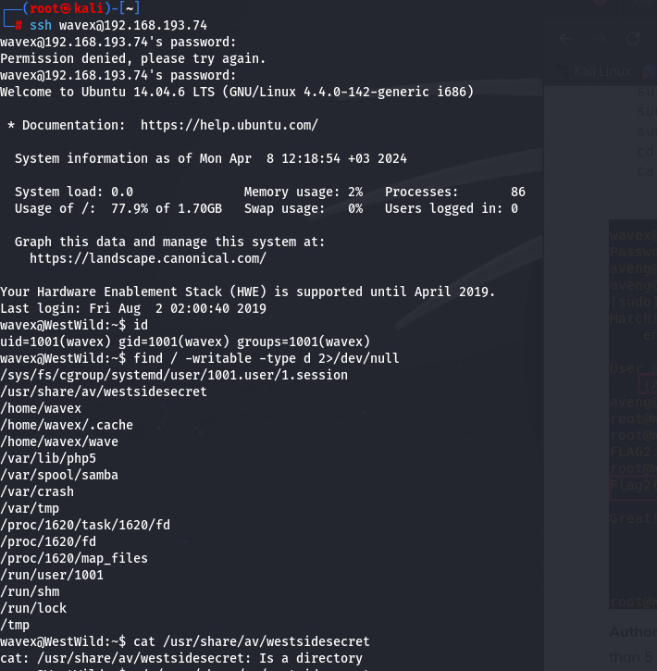
Now,we as try to get into wave@westwild root shell. The password is door+open.
Now we have successfully login into the westwild root shell.
Here are some commands for finding other flag
ssh wavex@192.168.1.104
find / -writable -type d 2>/dev/null
cd /usr/share/av/westsidesecret ls
cat ififorget.sh
But here I am going to give step by step commands.
Id
Cat /usr/share/av/westsidesecret
Cd /usr/share/av/westsidesecret
ls
Cat ififorget.sh

Slide 10
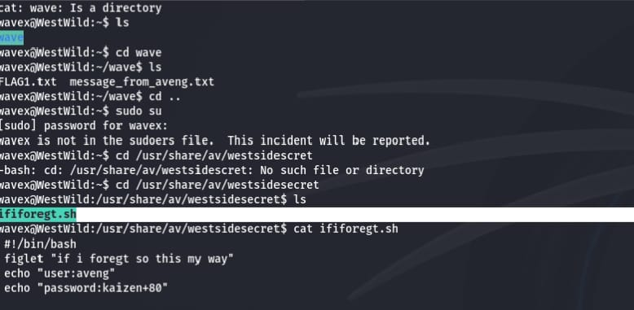
The wave root gives the txt of ififoregt.sh.we open this txt by cat command cat ififoregt.sh
We find user name and password
user: aveng
Password : kaizen+80
After finding the user name and password there are some commands to find the flag 2.
We switched to the user aveng using su command, put in the password. Now to get to the root shell we looked for the sudo permissions and found that this user can run all commands as root.
So we switched to the root shell using sudo su command and finally got the root flag.

Slide 11
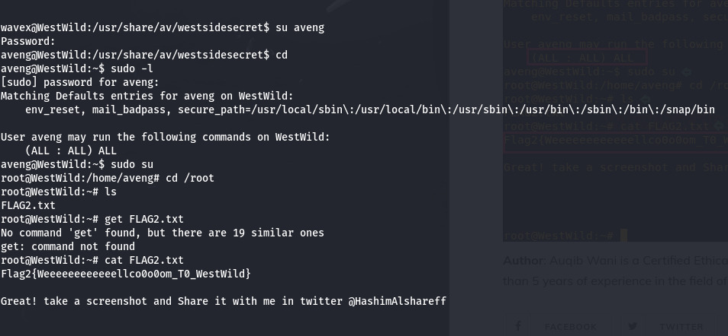
su aveng
sudo –l
sudo su
cd /root
cat FLAG2.txt
We get FLAG2.txt . After getting the Flag2.txt to open the txt use cat command.
We can the flag2{WeeeeeeeeeeellcoOoOm_TO_westwild}
At finally we found the two flags of westwild vunlhub machine.

